Slide 1
AES_Project_2021_2022
Politecnico di Milano
Automation and Control Engineering
Group’s Members:
Borgnino Michele
Crespi Davide Marco
Riva Alessandro
Firetto Alessandro

Slide 2
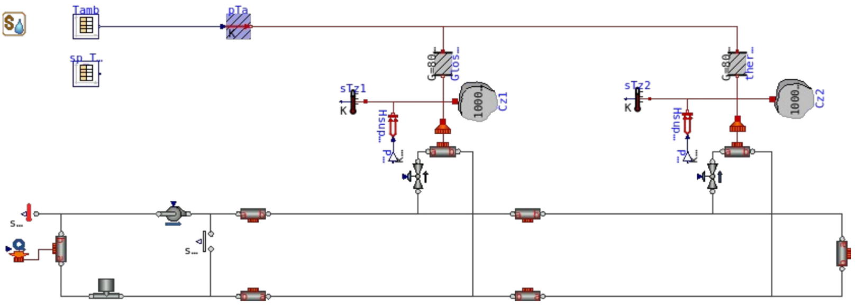

Slide 3
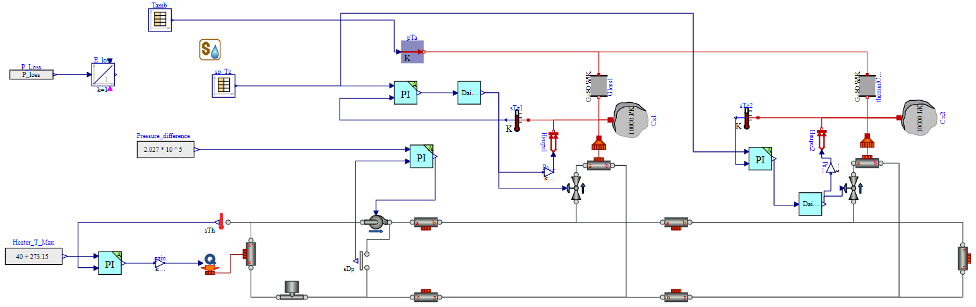

Slide 11
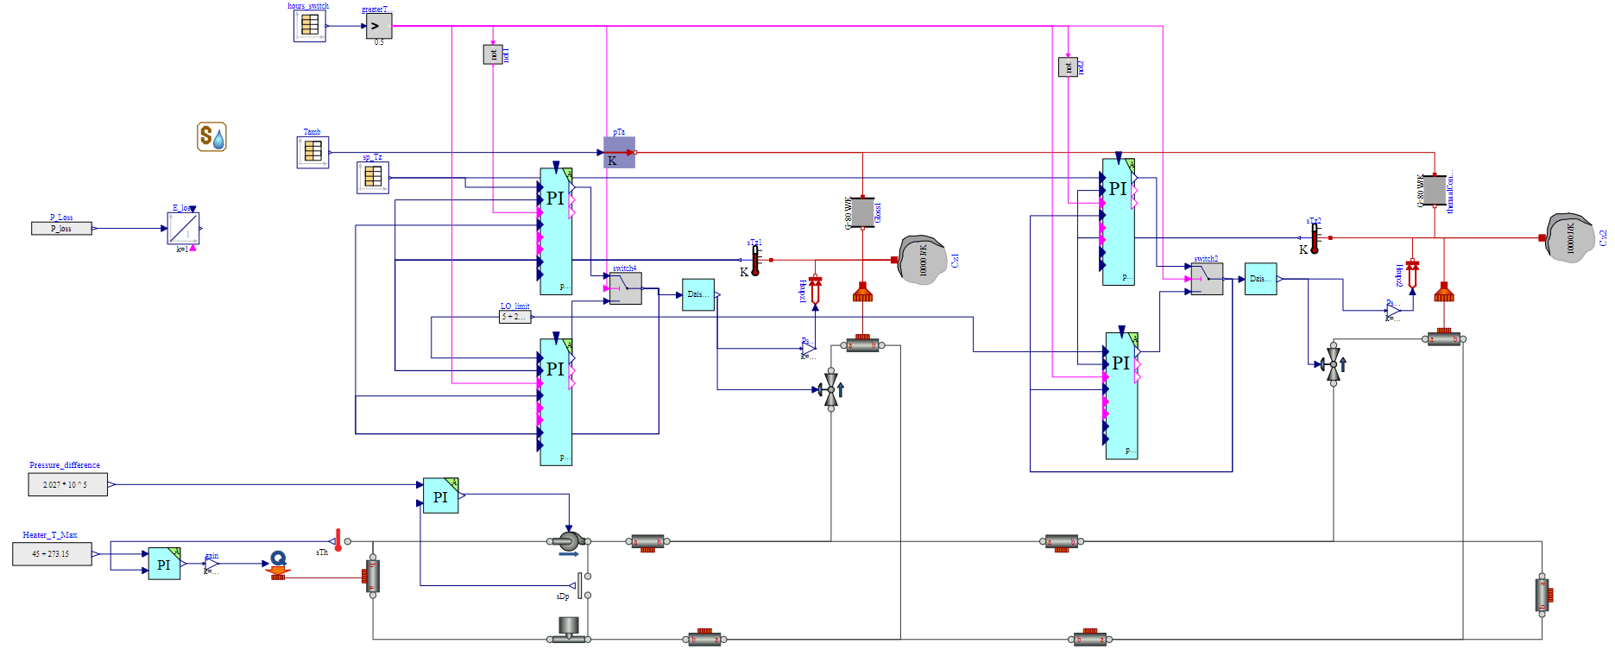
Model with the impletation of Day-Night Control

Slide 12
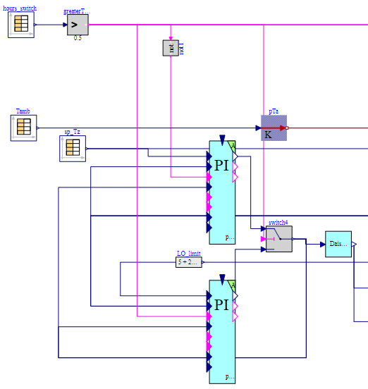
Components of the Logic Switching system:

Slide 13
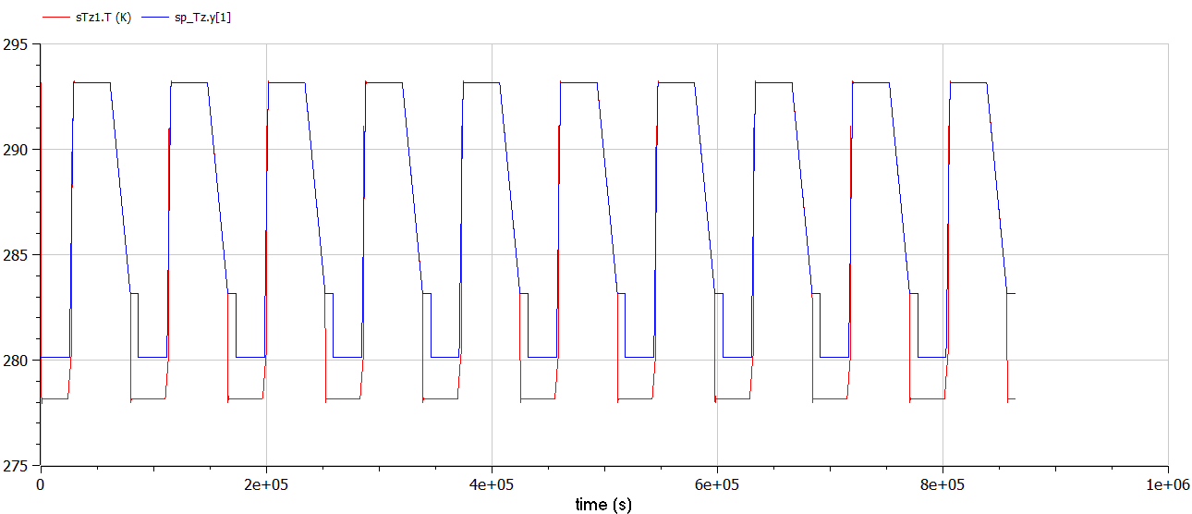
Temperature Traking of zone1

Slide 14
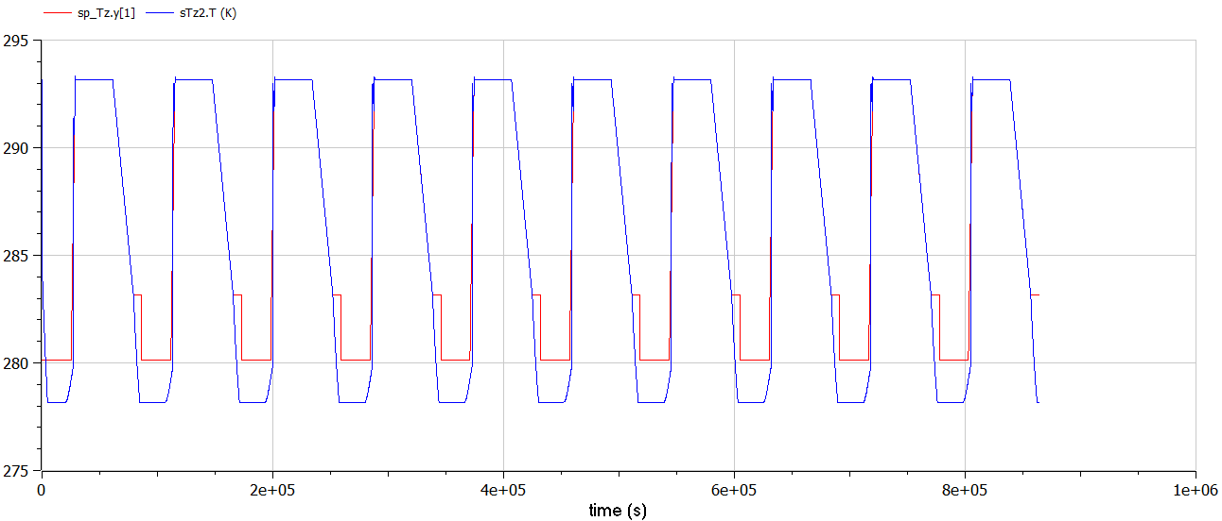
Temperature Traking of zone2

Slide 15
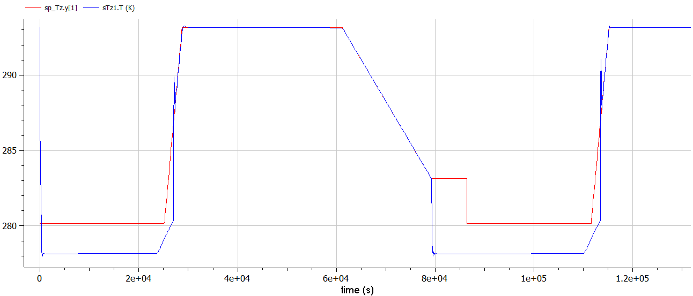
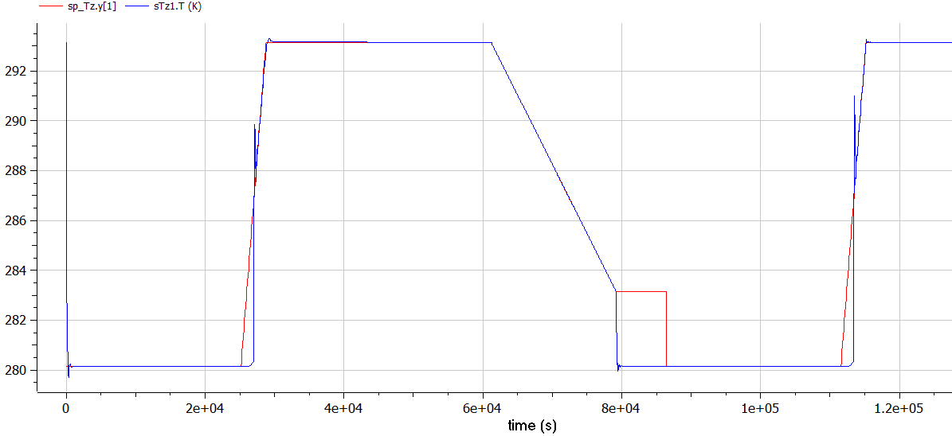
Comparison of the traking’s Temperature of the zone1 (for a single day) with different low limits
Low limit= 5+273,15K
Low limit= 7+273,15K

